Slide 1
Introduction to Tensorflow and Keras
FEB 2019
Prepared by - Ishan

Slide 2
1
Introduction to Tensorflow
2
Tensorflow Program and Coding
3
Coding Neural Network in Tensorflow
4
Keras

Slide 3
1
Introduction to Tensorflow
2
Tensorflow Program and Coding
3
Coding Neural Network in Tensorflow
4
Keras

Slide 4

What is TensorFlow™?
Open source software library for numerical computation using data flow graphs
Originally developed by Google Brain Team to conduct machine learning and deep neural networks research
General enough to be applicable in a wide variety of other domains as well TensorFlow provides an extensive suite of functions and classes that allow users to build various models from scratch.

Slide 5
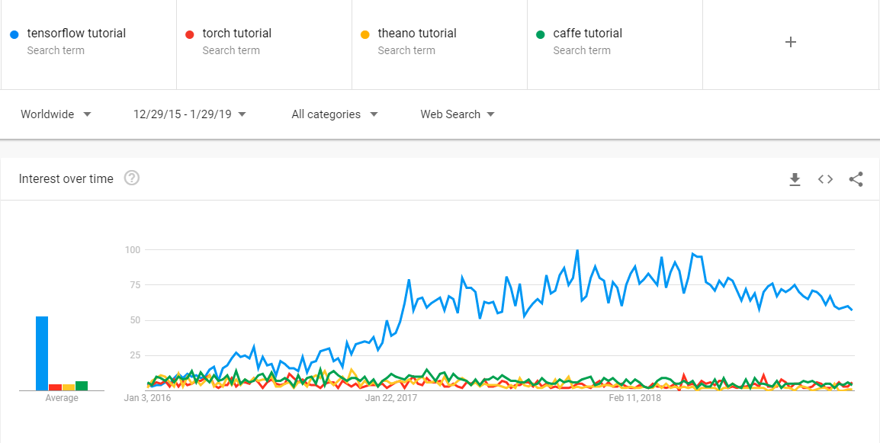
Why TensorFlow™?

Slide 6
Why TensorFlow™?
Python API
Portability: deploy computation to one or more CPUs or GPUs
Flexibility: from Android, iOS, Windows, Linux to server farms
Visualization (TensorBoard)
Checkpoints (for managing experiments)
Large community
Because Google !

Slide 7
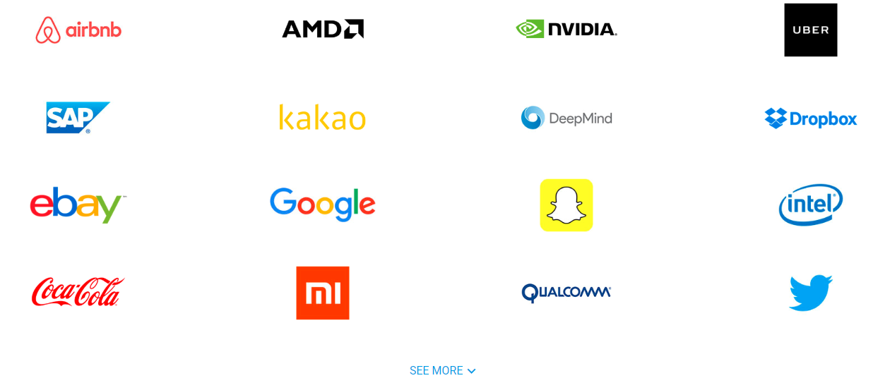
Some companies using tensorflow

Slide 8
1
Introduction to Tensorflow
2
Tensorflow Program and Coding
3
Coding Neural Network in Tensorflow
4
Keras

Slide 9
Tensorflow Program
Tensorflow Program
Construction Phase
(assemble a graph)
Execution phase
(use a session to execute operations in the graph)

Slide 10
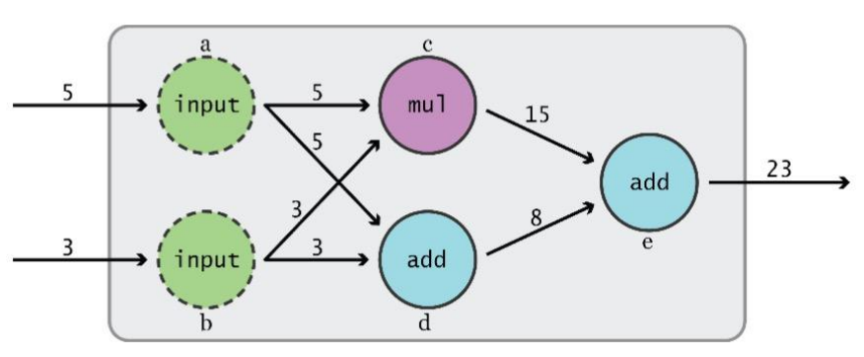
Data Flow Graphs
TensorFlow separates definition of computations from their execution

Slide 11
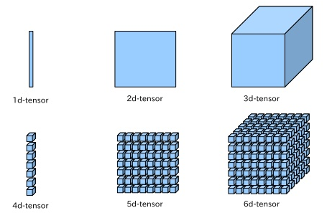
What is a tensor ?
An n-dimensional array or simply a data structure
0-d tensor: scalar (number)
1-d tensor: vector 2-d tensor: matrix
And so on

Slide 12
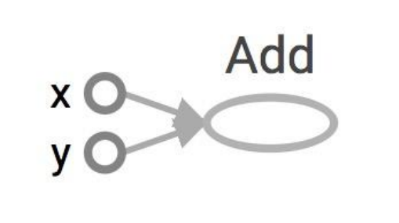
Data Flow Graphs
import tensorflow as tf
a = tf.add(3, 5)

Slide 13
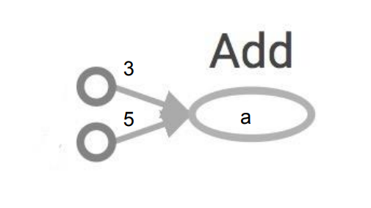
Data Flow Graphs
import tensorflow as tf
a = tf.add(3, 5)
Nodes: operators, variables, and constants
Edges: tensors Tensors are data.
Data Flow -> Tensor Flow!
Interpreted as

Slide 14
Data Flow Graphs
import tensorflow as tf
a = tf.add(3, 5)
print a
Nodes: operators, variables, and constants
Edges: tensors Tensors are data.
Data Flow -> Tensor Flow!
Interpreted as

Slide 15
Data Flow Graphs
import tensorflow as tf
a = tf.add(3, 5)
print a
>> Tensor("Add:0", shape=(), dtype=int32)
(Not 8)
Nodes: operators, variables, and constants
Edges: tensors Tensors are data.
Data Flow -> Tensor Flow!
Interpreted as

Slide 16
Data Flow Graphs : How to get the value of a?
Create a session
Assign it to variable sess so we can call it later
Within the session, evaluate the graph to fetch the value of a

Slide 17
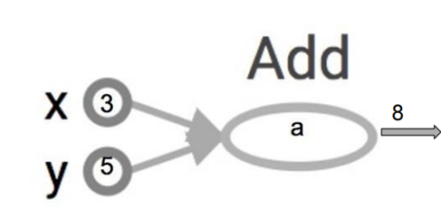
Data Flow Graphs : How to get the value of a?
import tensorflow as tf
a = tf.add(3, 5)
sess = tf.Session()
print sess.run(a)
sess.close()
The session will look at the graph, and think: How can I get the value of a?
then it computes all the nodes that leads to a.

Slide 18
tf.Session()
A Session object encapsulates the environment in which Operation objects are executed, and Tensor objects are evaluated.
In a sinlge-process TF, multiple sessions don’t share any state
Session would’ve it own copy

Slide 19
Tensorflow Program - Summary
Tensorflow Program
Construction Phase
import tensorflow as tf
a = tf.add(3, 5)
Execution phase
sess = tf.Session()
print sess.run(a)
sess.close()

Slide 20
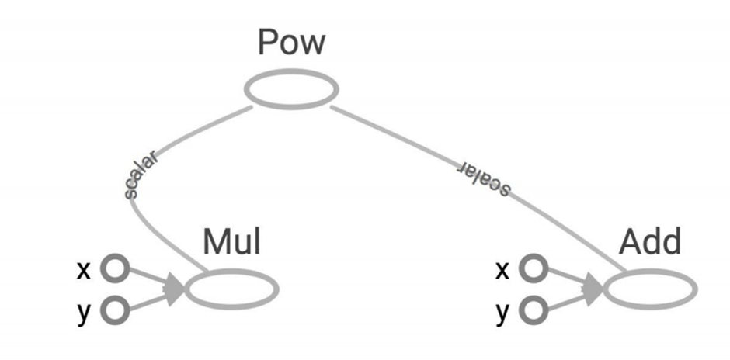
More Graphs
x = 2
y = 3
op1 = tf.add(x, y)
op2 = tf.mul(x, y)
op3 = tf.pow(op2, op1)
with tf.Session() as sess:
op3 = sess.run(op3)

Slide 21
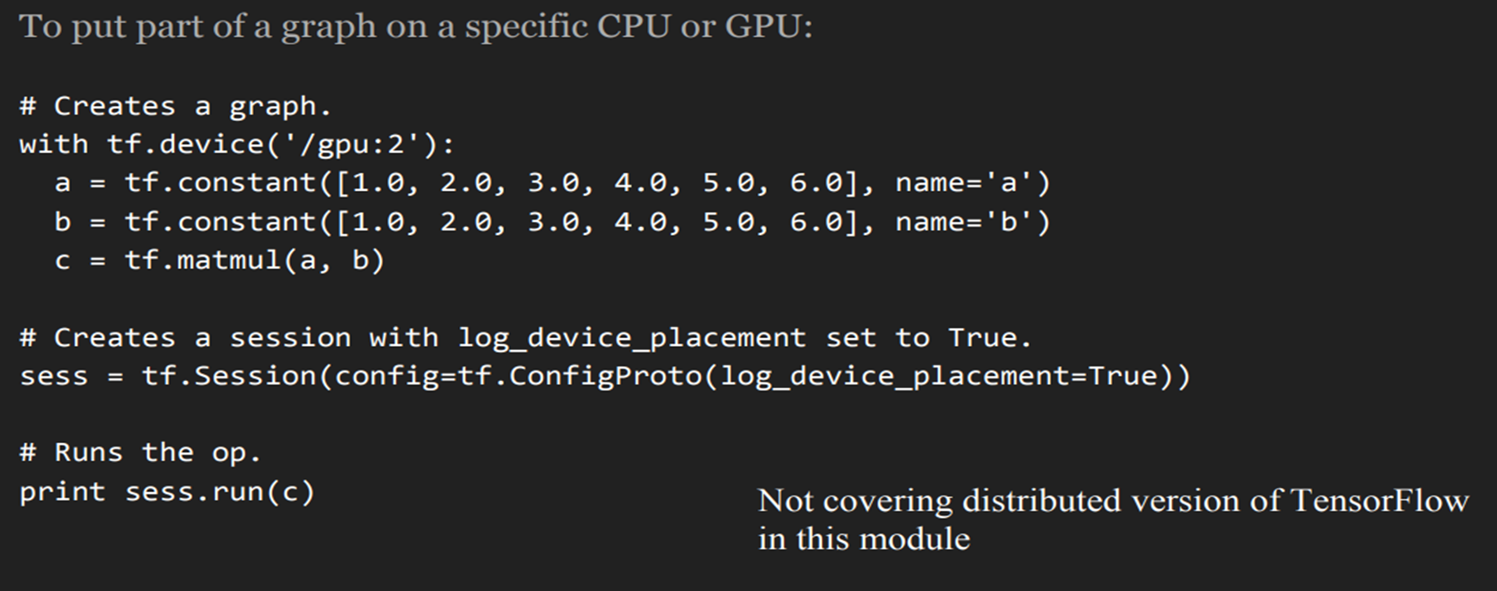
Distributed Computation in TF
Possible to break graphs into several chunks and run them parallelly across multiple CPUs, GPUs, or devices

Slide 22

Coding Time !
C:\Users\... > jupyter notebook

Slide 23
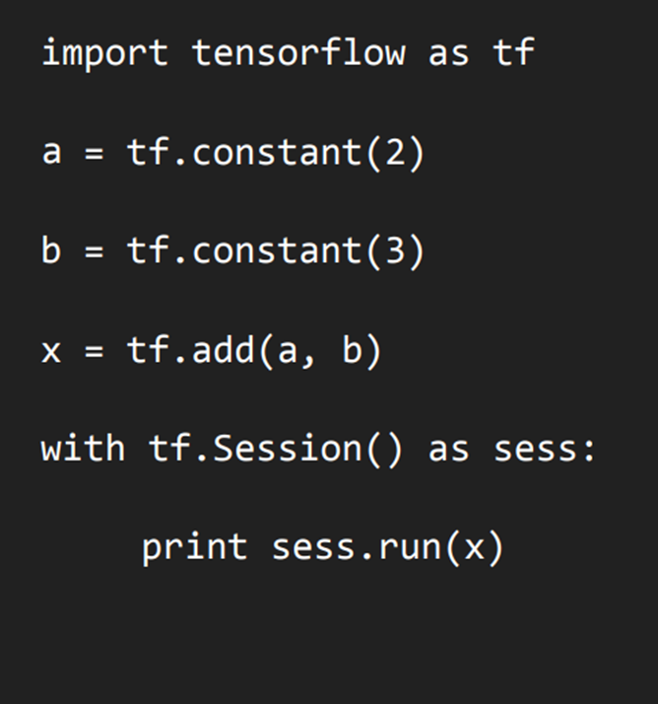
First tensorflow program

Slide 24
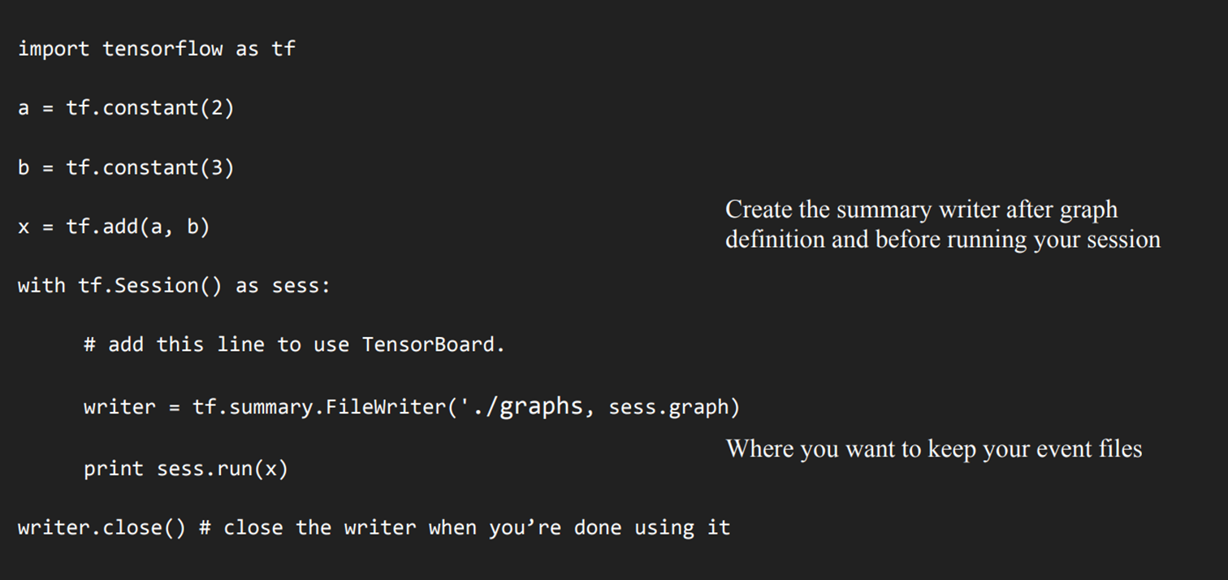
Using Tensorboard

Slide 25
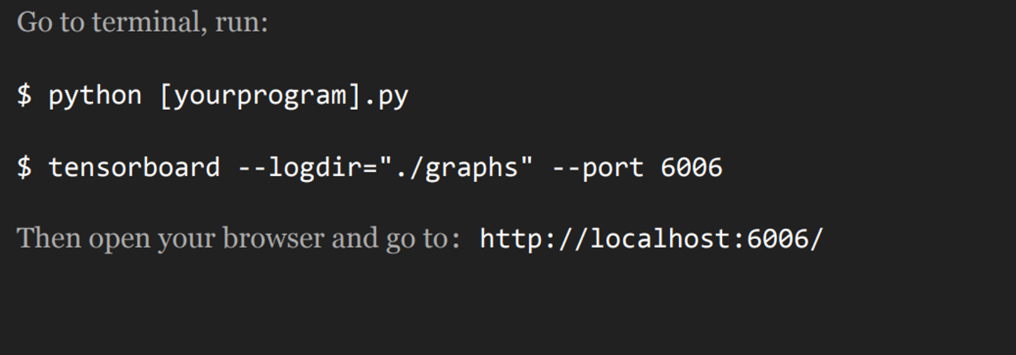
Running tensorboard

Slide 26
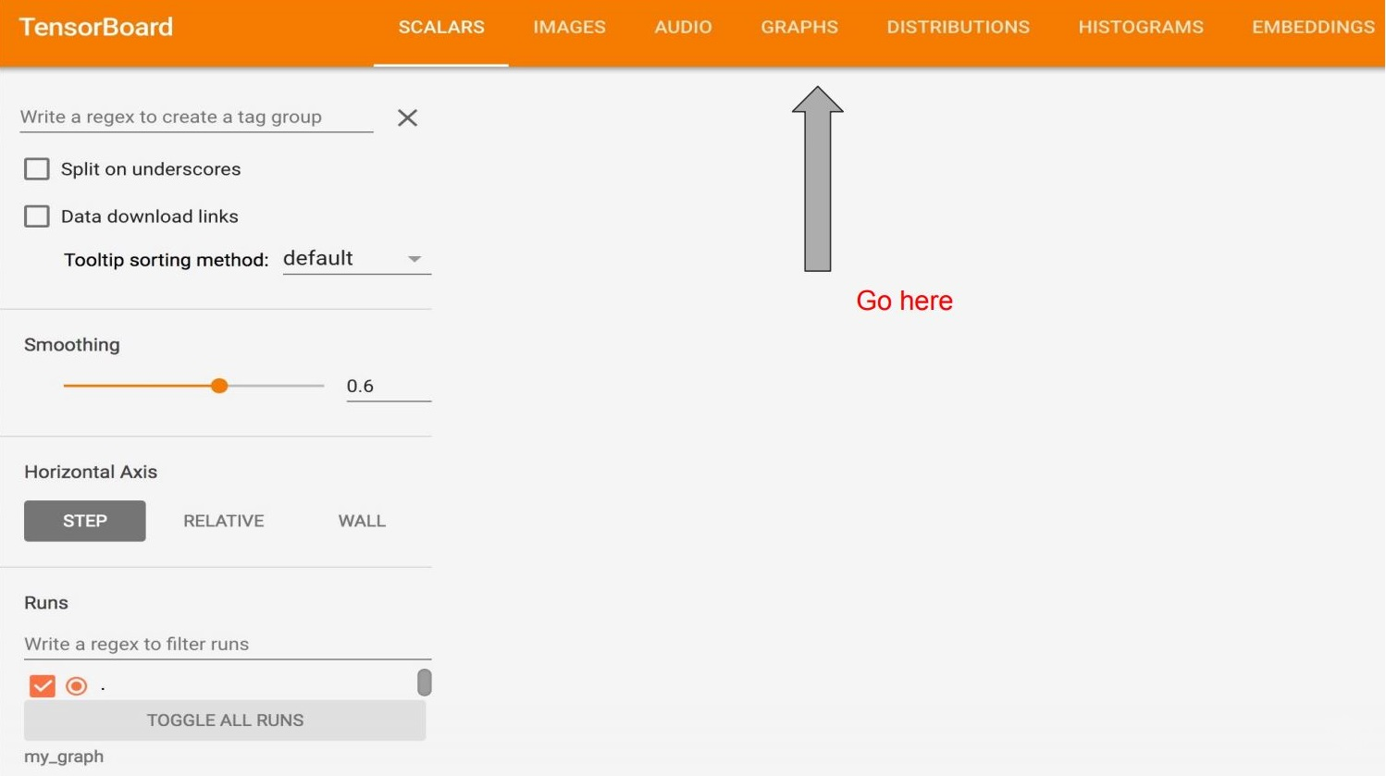

Slide 27
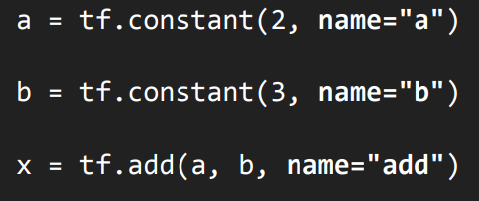
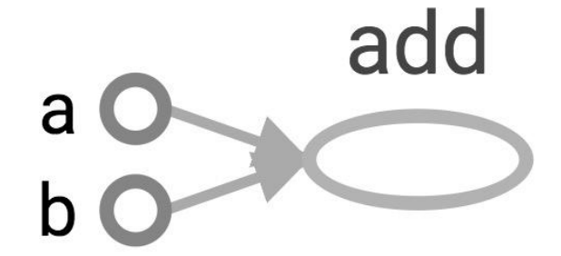
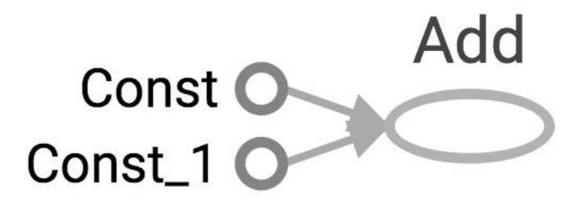
Changing the variable names

Slide 28
Learn to use TensorBoard well and often. It will help a lot when you build complicated models.

Slide 29
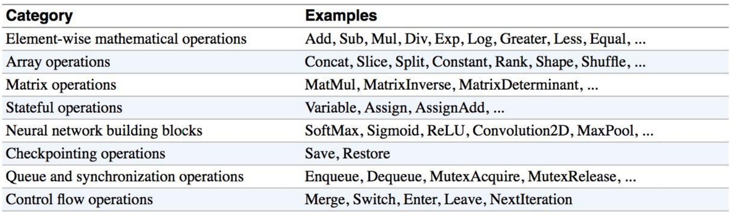
Some Tensorflow Operations

Slide 30
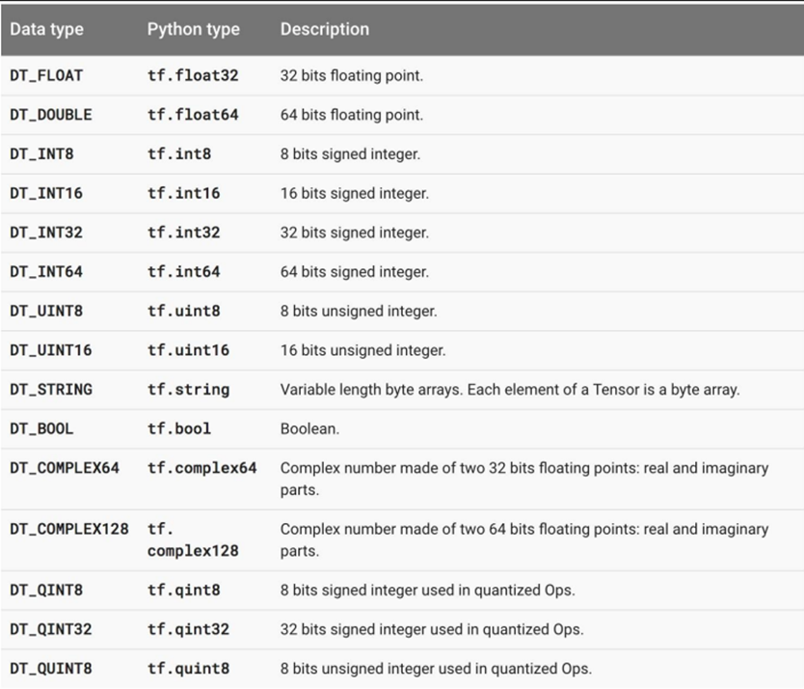
Some Tensorflow Datatypes

Slide 31
Coding Time !
Write a TF program to find cost of item after discount and visualize using tensorboard
Hint: Final_price = Current_price – (Current_price * Discount)/100

Slide 32
1
Introduction to Tensorflow
2
Tensorflow Program and Coding
3
Neural Networks for Handwritten Digits
4
Coding Neural Network in Tensorflow

Slide 33

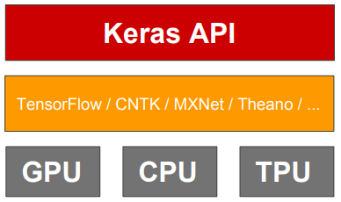
What is Keras ?
Keras is an open source neural network library written in Python.
It is capable of running on top of TensorFlow.
Designed to enable fast experimentation with deep neural networks, it focuses on being user-friendly, modular, and extensible

Slide 34
Three API Styles for Keras
The Sequential Model
Dead simple
Only for single-input, single-output, sequential layer stacks
Good for 70+% of use cases
The functional API
Like playing with Lego bricks
Multi-input, multi-output, arbitrary static graph topologies
Good for 95% of use cases
Model subclassing
Maximum flexibility
Larger potential error surface

Slide 35
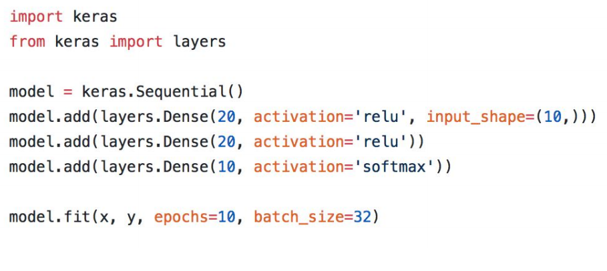
API Styles for Keras - The Sequential Model

Slide 36
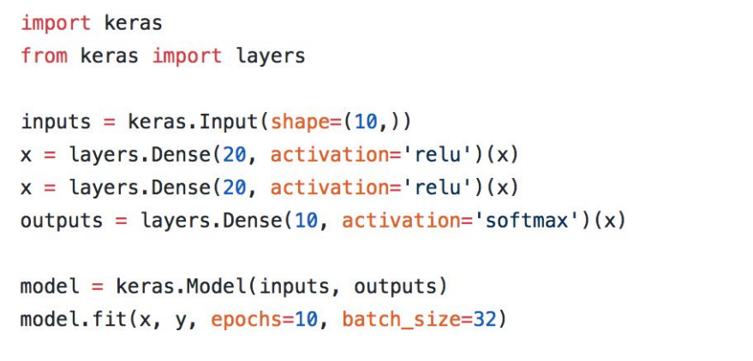
API Styles for Keras - The functional API

Slide 37
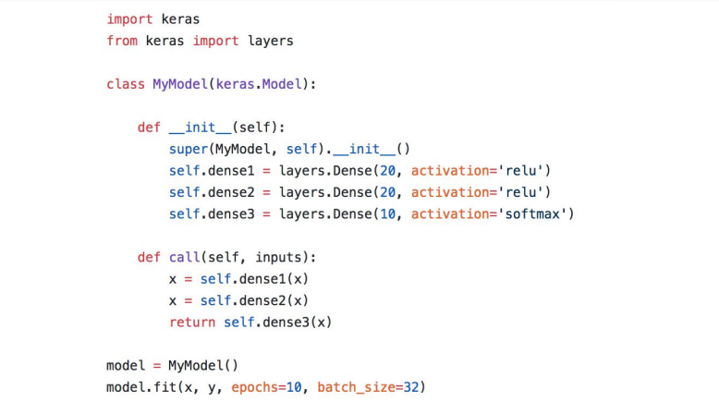
API Styles for Keras - Model subclassing

